Slide 1
3d-Printed Granular Jamming Hand
Melissa Indoe
Chris Kang
Sean Phelan
Maggie Serra
Chris Wallace

Slide 2
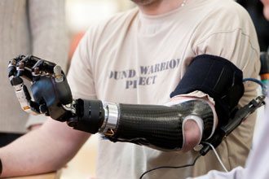
Problem Statement
Thousands of arm amputations each year
44% are below the elbow
Current prosthetics restore functionality but are not widely available or cost efficient
Only about half of arm amputees even get access to prosthetics
There is a need to create an affordable, readily available prosthesis

Slide 3
Project Objective
Create an open-source, high functioning, affordable, 3-D printed prosthetic hand
Costs less than $500
Able to perform a number of low-strength, high dexterity tasks
Designed for manufacture on a consumer-level 3-D printer
Open source
Anyone can download the design from the internet and modify the hand to suit their own needs
Semester Objectives
Finishing up design and coding
Fabricate a working prototype

Slide 4
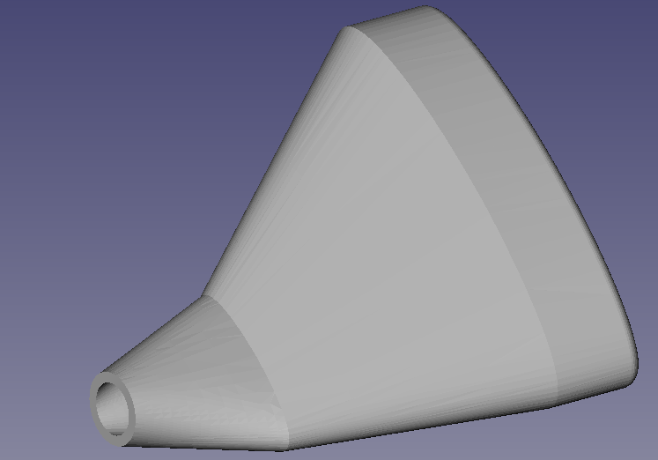
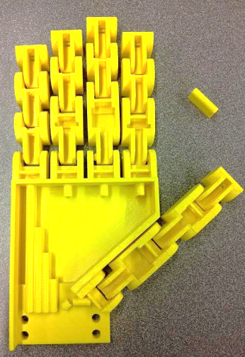
Deliverables
Phase 4:
3D printed the first complete hand
Started programming for the Arduino Uno
Began editing the forearm model
Started developing methods for granular jamming pad production
Ordered major parts
Continued development of the project website

Slide 5
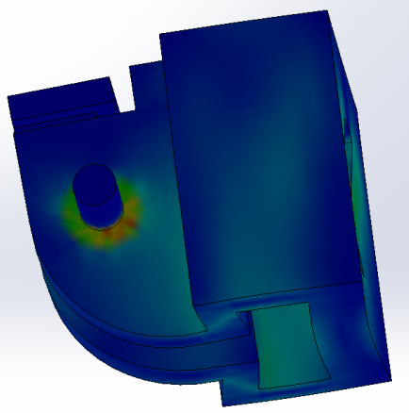
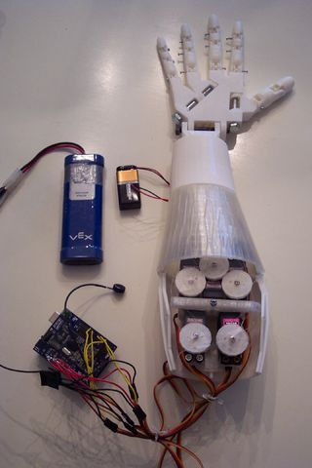
Project Review
3D Printing
Joint pin analysis
Showed that material and geometry of finger withstand forces under working conditions
Manufacturability analysis
Showed that the hand could be printed in one piece
Granular Jamming
Tested the importance of application
Found that it should be included in the palm only
Found required size and pressure differential
Finger Control
Hall Effect sensors to be used
Fishing line used to connect fingers and motors
Arduino control

Slide 6
Project Review—Design Analysis
Joint pins:
By Phase 3, the team planned on using cylindrical printed joint pins
This allowed the hand to be printed as a non-assembly model
The team also proved that this design was capable of withstanding forces under working conditions
Models showed that forces are transferred first to the hinges, then to the pins
This means that while the pins are the weakest point, they are protected by the hinges from damage
During manufacturing, warping occurred around joint pins
This was corrected with the addition of bearings to reduce friction and correct pin placement
In Phase 4, these cylindrical joint pins were replaced with conical pins
Conical pins include less overhangs due to the fact that they “step” upward in gradient
They also eliminate the need for bearings

Slide 7
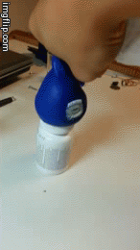
Project Review—Design Analysis
Granular Jamming:
Concept: small particles in a flexible container act as a fluid and become rigid when packed tightly
This is capable of picking up relatively small objects
75kPa pressure differential is sufficient
Materials: coffee grounds, foam as a filter, latex for housing
First latex prototype is to occur during Phase 5
Will be implemented with the rest of the hand
Control will be to either manually turn on and off or automatically run the vacuum when enough contact is made
Testing will determine which is sufficient
Bluetooth will not be supported by the team but will be possible

Slide 8
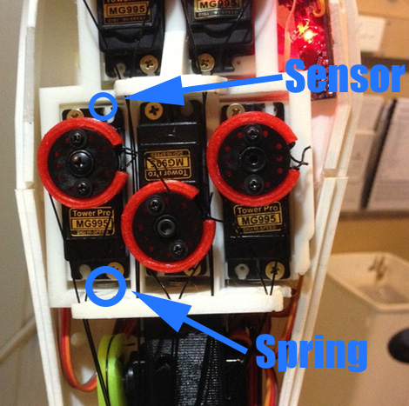
Project Review—Design Analysis
Finger Control:
Fishing line will be tied to the tips of the fingers and reeled in by servo motors
However, servo motors cannot sense contact and will burn out
The Hall Effect sensors will be used to solve this problem
Springs will enable motors to slide
A magnet is attached to each motor, sensor are attached to the housing
Arduino will recognize reading of magnetic field converted to voltage and command motors to either reel in or stop
Design adjustments and troubleshooting will be taken care of during Phase 6

Slide 9
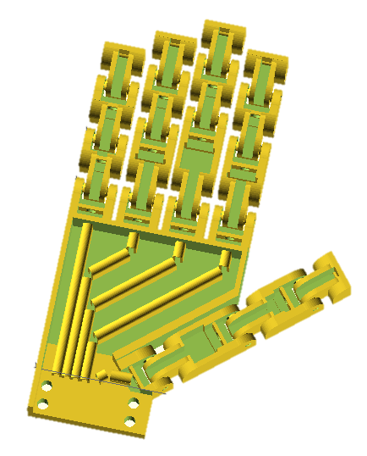
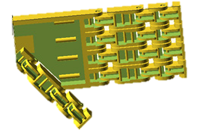
Design Modifications
There were a large number of design modifications made between phases 3 and 4
Modifications were as follows:
Updates to the base finger model
Updates to the palm model
Generation of unique finger models
Unique models were created for the
ring/index fingers, the thumb, and the
pinky
Previous (left) and current (right) hand iterations. Current hand iteration includes updated palm, updated base finger design, and realistic finger lengths.

Slide 10
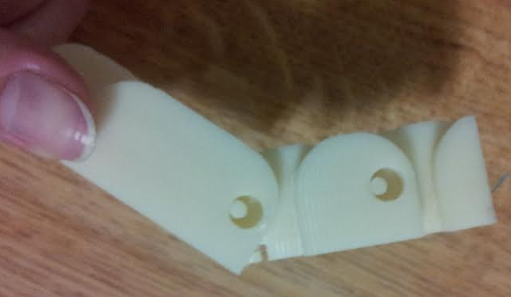
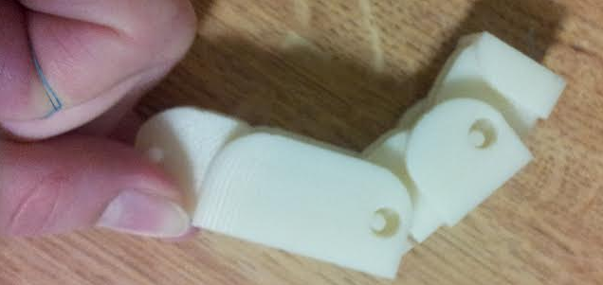
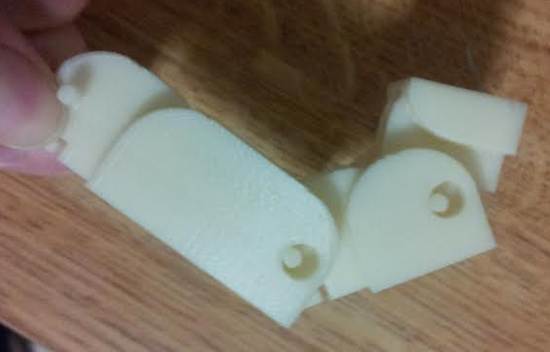
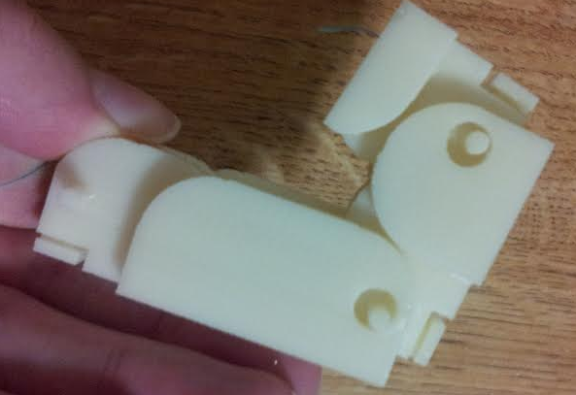
Base Finger Updates
The finger design created at the end of phase 3 was fully functional
However it was still possible to increase its ease of manufacture and its range and quality of motion
Previous finger iteration. Note the looseness of joint pins in their housings and the fact that the finger is bent to not quite 90 degrees at each joint. This is due to internal friction with the cable guides.

Slide 11
Base Finger Updates: Solution
Tapered joint pins
These improve ease of manufacture by greatly reducing the degree of overhangs
They also eliminate the need for bearings
Redesigned and repositioned cable guides
The new cable guides are flat faces with a hole for wire
This eliminates overhangs, a huge improvement over rod-shaped guides
The change in position also prevents friction when the finger is bent
Much more intuitive to wire
Smaller tolerances
Changed to a commonly accepted value suggested by a TA
Meant to reduce joint rattle
Reduced height
This makes the fingers slightly less blocky and more realistic

Slide 12
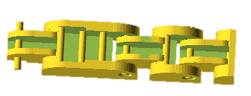
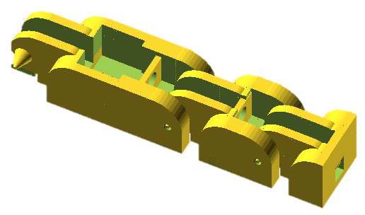
Base Finger Updates: Comparison
Previous finger iteration (left) with pin-shaped cable guides, round joint pins, and large tolerances, and new finger iteration (right) with redesigned cable guides, conical pins, and lower tolerance.

Slide 13
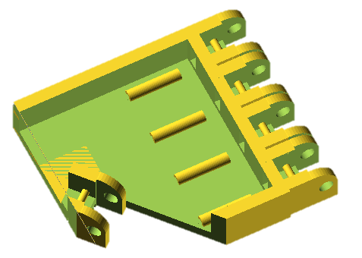
Palm Updates
The palm design was roughed out at the end of phase 3
However there was an understanding that it was not ready for manufacture
Problems with Phase 3 Palm Model:
Low-level cable guides
Forcing the cables down decreases leverage on the fingers
No guard between granular jamming pad and thumb
This could create friction with the thumb and prematurely wear out the granular jamming pad
No mounting point for the forearm
Sidewalls were very thick
This simply wastes plastic and adds extra weight
Palm design at the conclusion of phase 3.

Slide 14
Palm Updates: Solution
Taller and more complete cable guides
Guides now run through the entire palm
Therefore wire cannot generate friction with the granular jamming pad
Height is increased
Prevents wire from getting forced downward and impeding finger motion
Mounting point for forearm added
Includes four holes for plastic screws
Holes are slightly larger than screw diameter
This makes it possible to thread them into the forearm, ensuring a tight fit
Guard for thumb added
Prevents the granular jamming pad from creating friction with the thumb
Ensures good range of motion for the thumb and prevents wear on the pad
Thinner sides
Decreases weight and plastic usage
Larger finger spacing
Prevents bridging between fingers, ensures correct finger motion

Slide 15
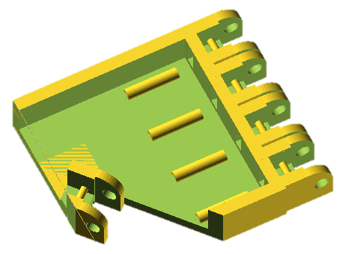
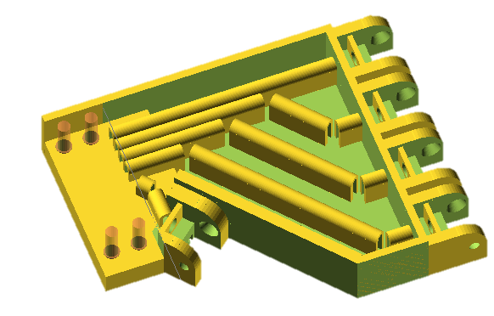
Palm Updates: Comparison
Previous palm iteration (left) with low level cable guides, no forearm mount, and no thumb guard. Current palm iteration (right) with and more complete cable guides, a forearm mount, and a thumb guard.

Slide 16
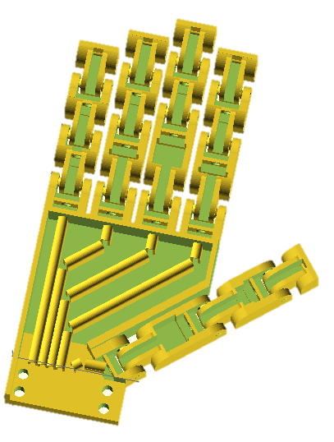
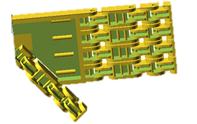
Overall Hand Updates
At the end of Phase 3 a hand design had been completed with all equally sized fingers
The hand was updated with finger lengths adjusted to exactly the length of average real, human fingers
All fingers (except the pinky) are exactly the length of the average human equivalent
The pinky is 10mm longer due to hinge constraints
Side by side comparison of old and new hand models.

Slide 17
Granular Jamming Pad
The granular jamming pad has been designed
A production plan for the granular jamming pad has also been developed
3D pad model will be used to create two halves of a mold model
Mold will be 3D printed out of ABS plastic
This mold will then be used to slip cast latex for the pad
Granular jamming pad design.

Slide 18
Prototype Fabrication and Cost
First complete hand prototype was printed February 6th
All 3D printed parts are produced through Carnegie lab
Majority of non-printable 3D parts (motors, pump, etc) have been ordered
Cost so far: $138
$131 has been spent on non-3D printable materials
$7.05 has been spent in materials cost for the hand
Future plans for fabrication:
Hand design will be finalized within the next 1-2 weeks
Granular jamming pad design will be finalized and produced within the next 1-2 weeks
Forearm design will be finalized within the next 1-2 months

Slide 19
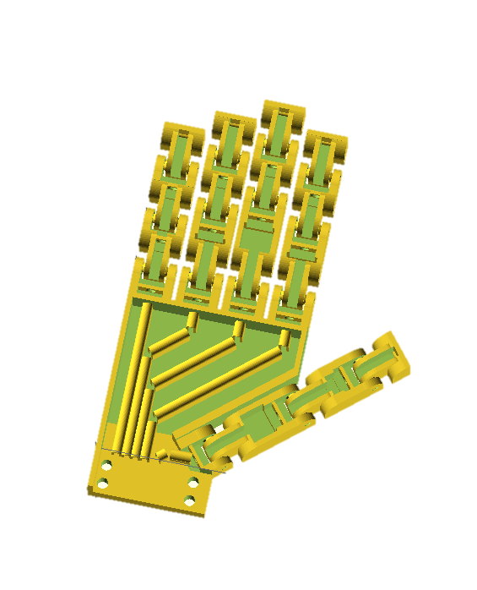
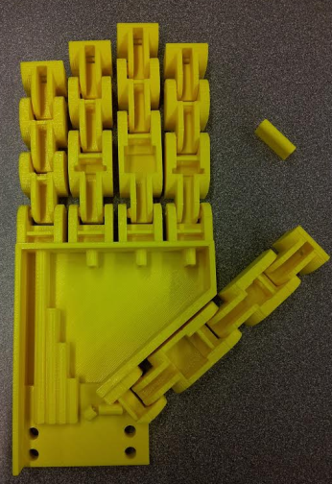
Performance Testing
The first iteration of the complete hand was a moderate success
Certain elements behaved as expected
Some elements need further improvement
The thumb is especially problematic
Modeled (top) and printed (bottom) hand.

Slide 20
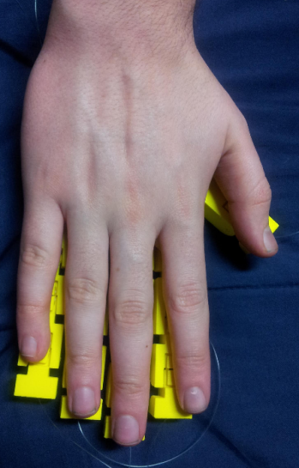
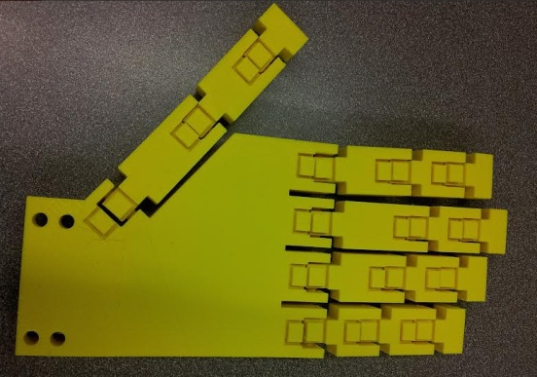
Performance Testing— Good Points
Redesigned fingers were all successful
New cable guides increased range of motion and printed successfully
Base knuckle (never previously tested) acted as expected
Fingers all worked at respective lengths
Revolute portions of the joints worked as expected
Proportions are correct
Palm design spaced fingers a reasonable distance apart
No bridging occurred between fingers
Thumb did not bridge to side of hand and could bend freely
Hand model compared to a human hand.

Slide 21
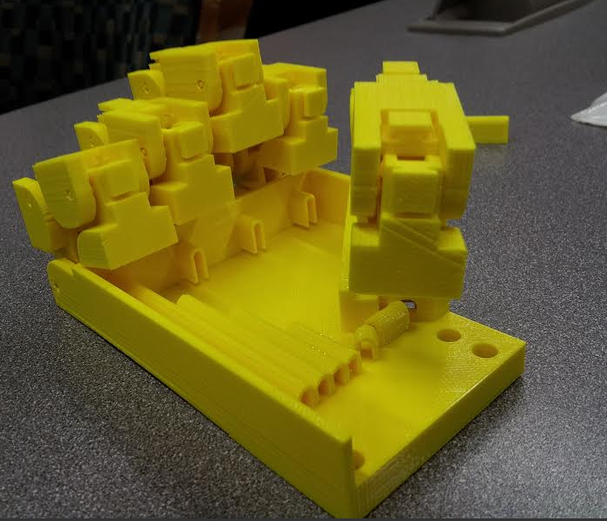
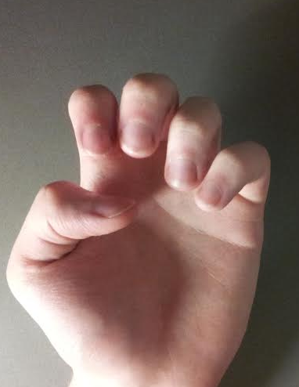
Performance Testing—Points of Failure
Finger tolerance was too small
Friction within joint segments, bridging occurred
Cable guides detached from palm surface
This was entirely a design error, which has since been rectified
Thumb bends incorrectly
This is a major issue that will need to be addressed for the next iteration
Hand model compared to a human hand—demonstrating correct finger motion and incorrect thumb.

Slide 22



Prototype—Moving Forward
Floating wire guide issue has already been fixed
Plastic thickness at forearm attachment point has been reduced
This reduces weight of the hand and amount of plastic used
Wire guides will be redesigned
Testing showed that the wire guides are effective at ½ current height
Making them shorter also allows more space for the granular jamming pad
New cross section will be solid posts with circular holes at the top
This is to make threading the wire guides easier
Thumb must be redesigned
This will be the most involved part of the next iteration
The angle of attachment can be mirrored, causing the hand to have an unnatural resting state
Alternately the overall design of the thumb as another finger will be revisited

Slide 23
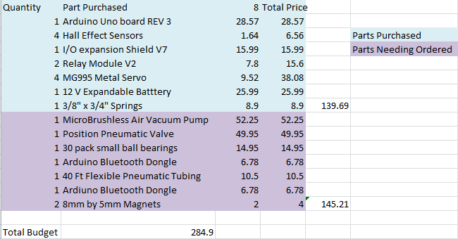
Bill of Materials

Slide 24
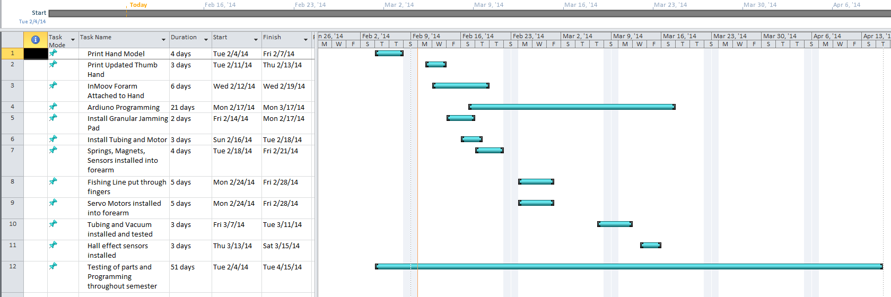
Gantt Chart

Slide 25
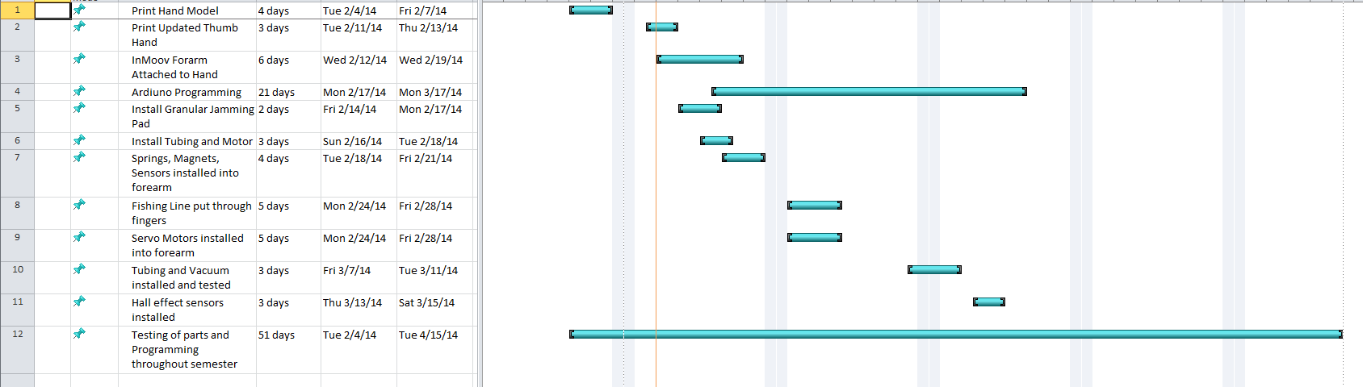
Construction/Testing Time Table

Slide 26
Next Phase Deliverables
Phase 5:
Test and iterate the hand and granular jamming system
Finalize designs for both elements
Complete programming for the Arduino Uno (except for necessary modifications as testing continues)
As parts will be delivered and assembled
The forearm model will be completed and prototyped
Website will be completed
Notes:
Arduino- adjusting speed, sensor sensitivity, etc

